Slide 1
Embedded System and Microcomputer Principle
LAB2 General-purpose Input/Output
2021 Fall
wangq9@mail.sustech.edu.cn

Slide 2
CONTENTS
1
GPIO Function Description
2
How to create a new project
3
How to programming
4
Practice

Slide 3
01
GPIO Function Description

Slide 4
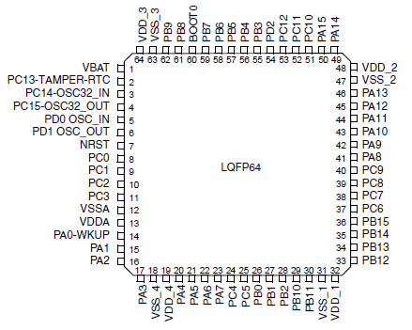
1. GPIO Function Description
There are 4 groups of I/O in STM32F103RCT6
51 I/O ports
GPIOA0~A15
GPIOB0~B15
GPIOC0~C15
GPIOD0~D2
16*3 + 3 = 51

Slide 5
1. GPIO Function Description
Each GPIO port in STM32 can be individually configured by software in 8 modes
输入浮空 Input floating
输入上拉 Input pull-up
输入下拉 Input pull-down
模拟输入 Analog
开漏输出 Output open-drain with pull-up or pull-down capability
开漏复用功能 Alternate function open-drain with pull-up or pull-down capability
推挽式输出 Output push-pull with pull-up or pull-down capability
推挽式复用功能 Alternate function push-pull with pull-up or pull-down capability
More about GPIO and the corresponding feature
https://blog.stratifylabs.co/device/2013-10-21-Understanding-Microcontroller-Pin-Input-Output-Modes/
http://www.openedv.com/posts/list/21980.htm

Slide 6
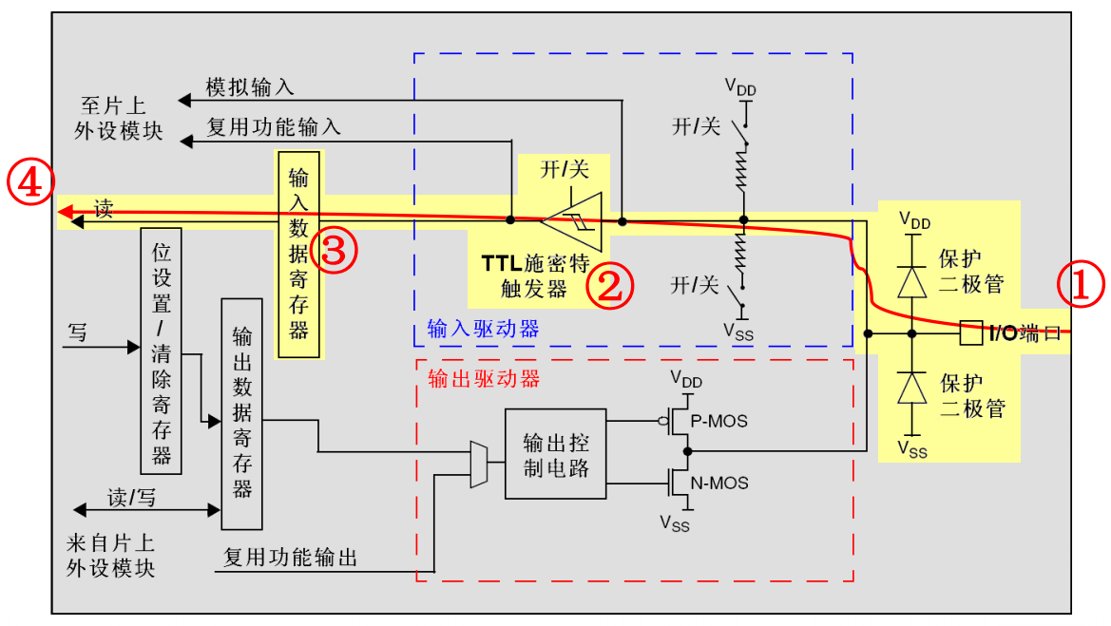
1. GPIO Function Description
Input floating

Slide 7
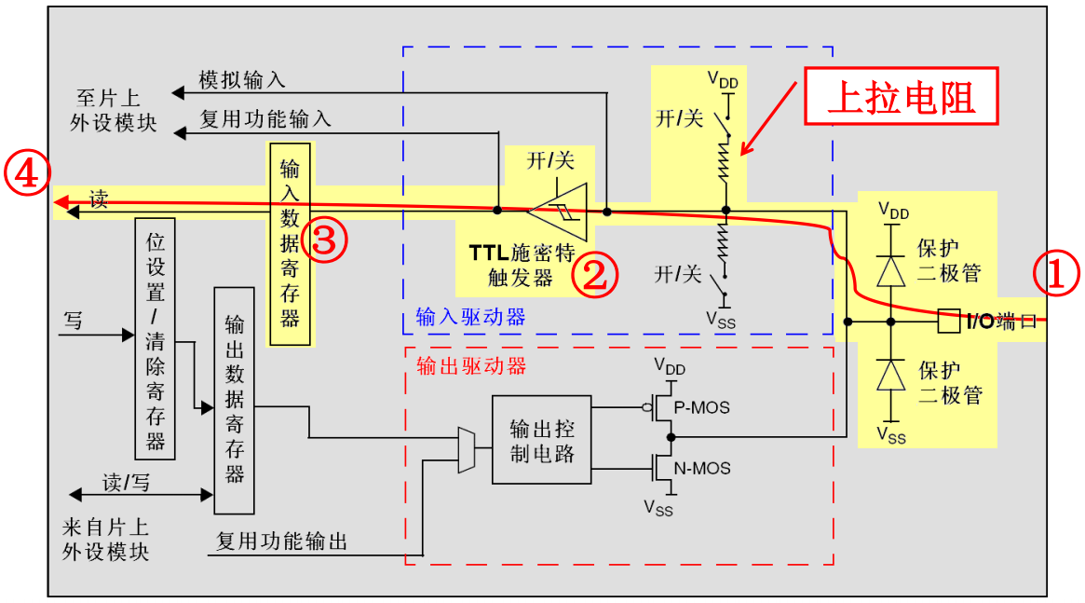
1. GPIO Function Description
Input pull-up

Slide 8
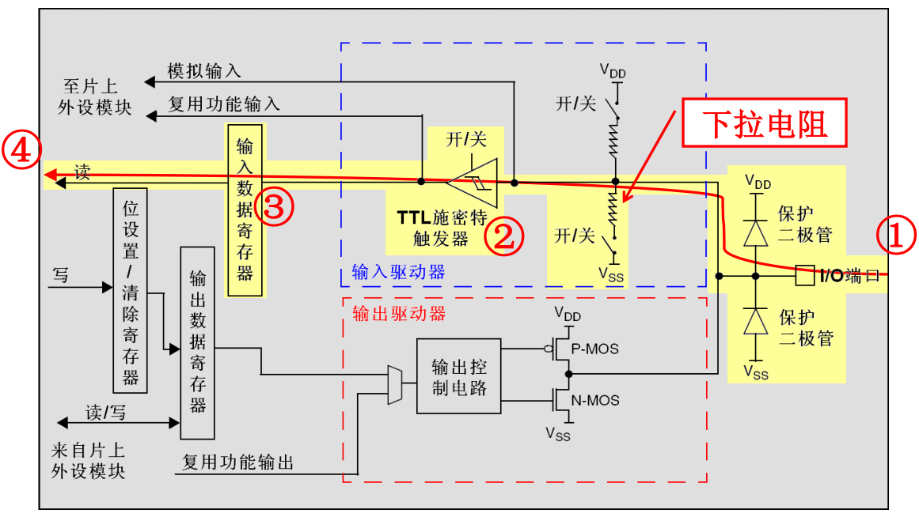
1. GPIO Function Description
Input pull-down

Slide 9
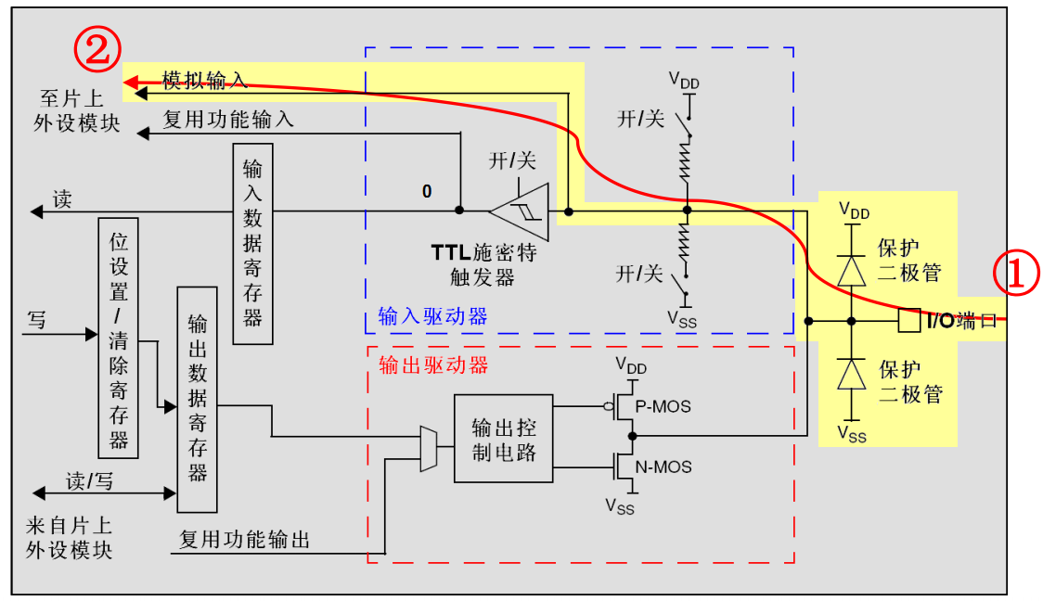
1. GPIO Function Description
Analog

Slide 10
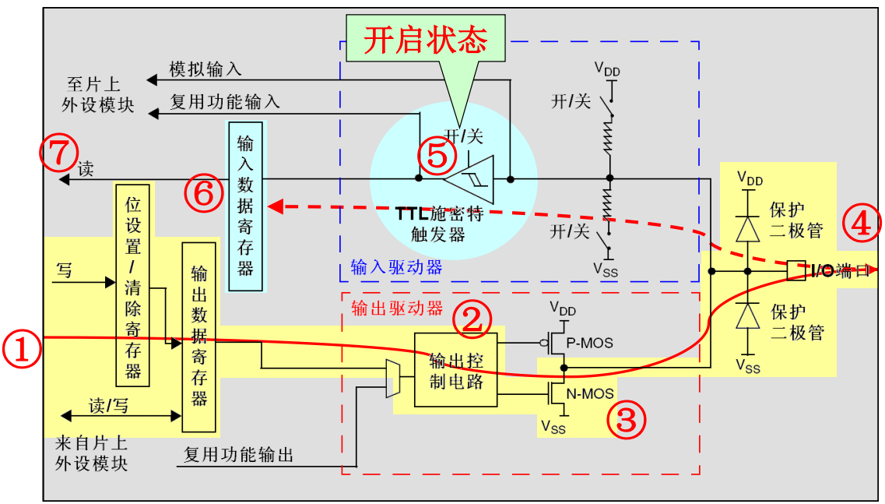
1. GPIO Function Description
Output open-drain

Slide 11
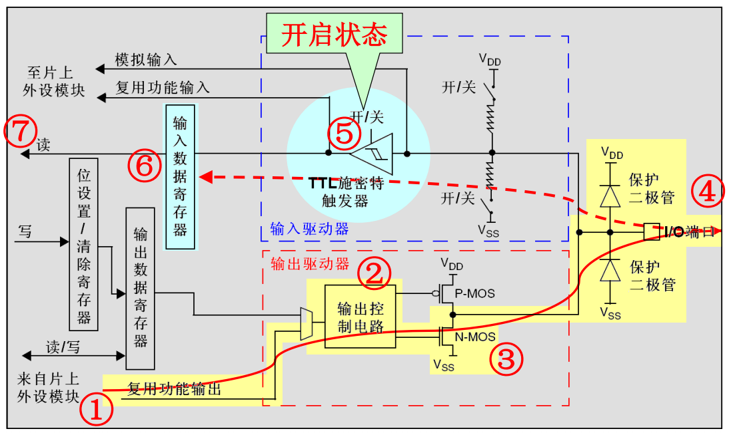
1. GPIO Function Description
Alternate function open-drain

Slide 12
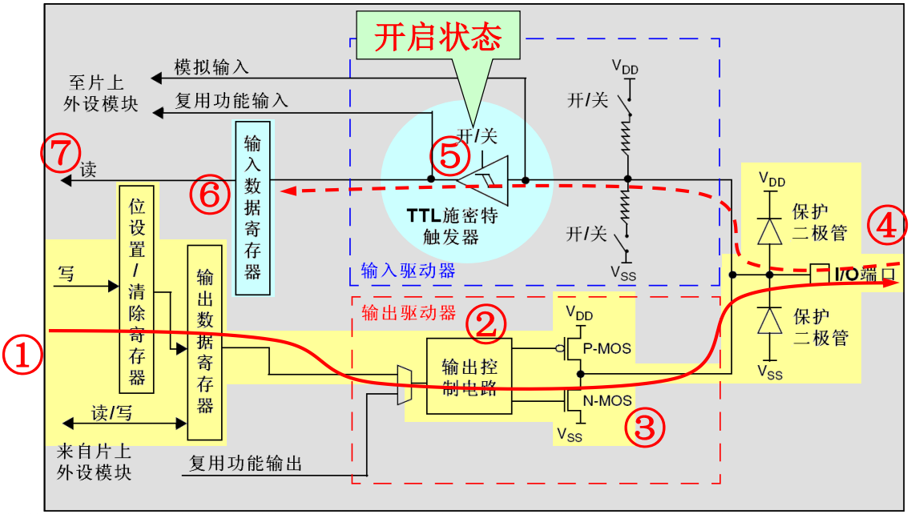
1. GPIO Function Description
Output push-pull

Slide 13
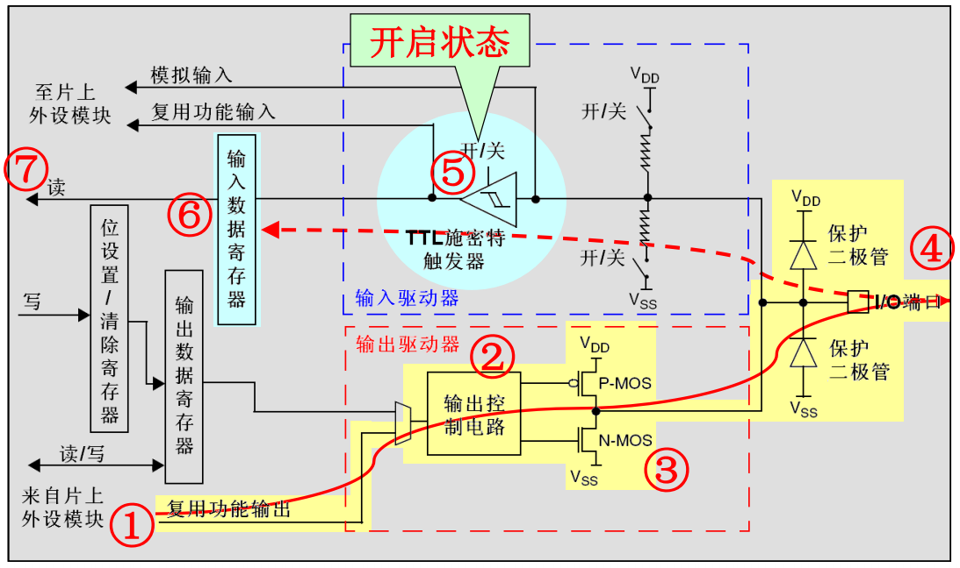
1. GPIO Function Description
Alternate function push-pull

Slide 14
1. GPIO Function Description
Each group GPIO ports has 7 registers
two 32-bit configuration registers (GPIOx_CRL, GPIOx_CRH)
GPIOx_CRL: Port configuration register low
GPIOx_CRH: Port configuration register high
two 32-bit data registers (GPIOx_IDR, GPIOx_ODR)
GPIOx_IDR: Port input data register
GPIOx_ODR: Port output data register
a 32-bit set/reset register (GPIOx_BSRR)
a 16-bit reset register (GPIOx_BRR)
a 32-bit locking register (GPIOx_LCKR)
Each I/O port bit is freely programmable, however the I/O port registers have to be accessed as 32-bit words (half-word or byte accesses are not allowed)

Slide 15
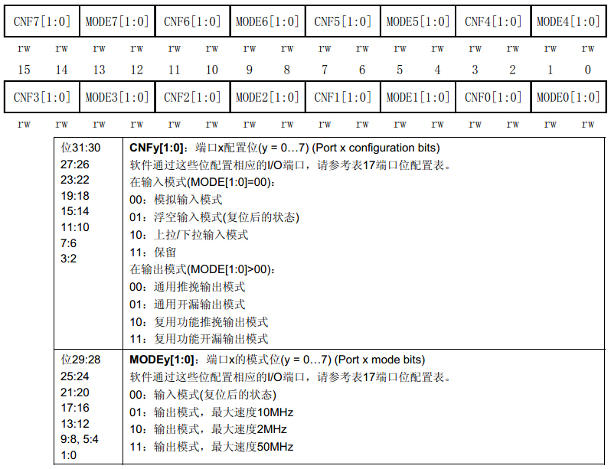
1. GPIO Function Description
-- 端口配置低寄存器(GPIOx_CRL)

Slide 16
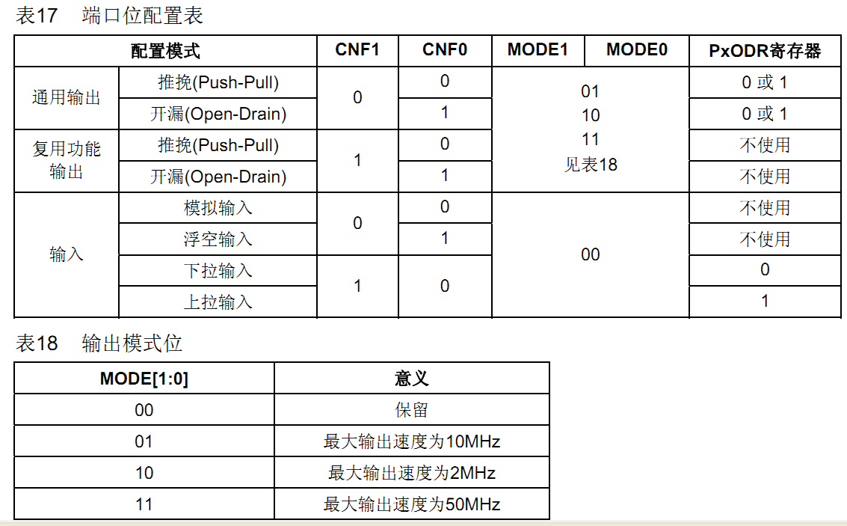
1. GPIO Function Description
-- 端口配置低寄存器(GPIOx_CRL)

Slide 17
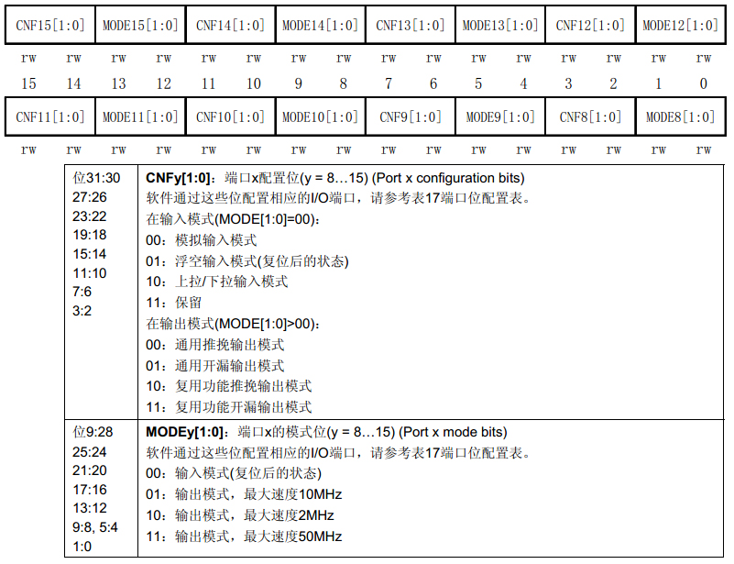
1. GPIO Function Description
-- 端口配置高寄存器(GPIOx_CRH)

Slide 18
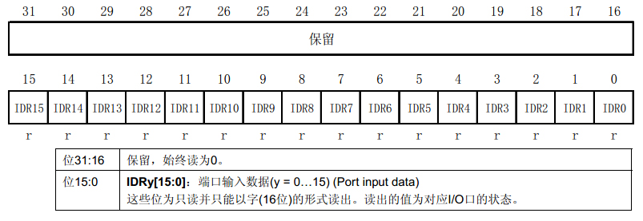
1. GPIO Function Description
-- 端口输入数据寄存器(GPIOx_IDR)

Slide 19
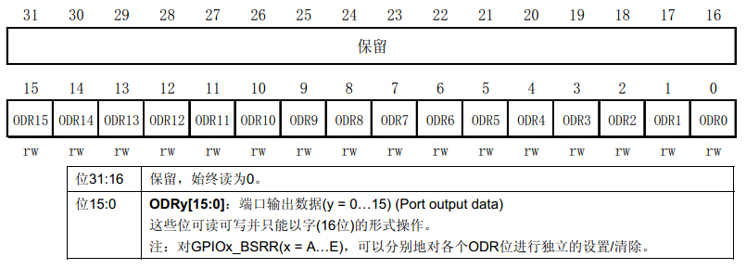
1. GPIO Function Description
-- 端口输出数据寄存器(GPIOx_ODR)

Slide 20
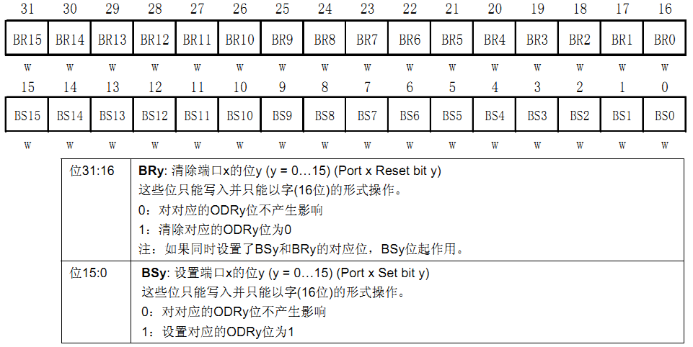
1. GPIO Function Description
-- 端口位设置/清除寄存器(GPIOx_BSRR)

Slide 21
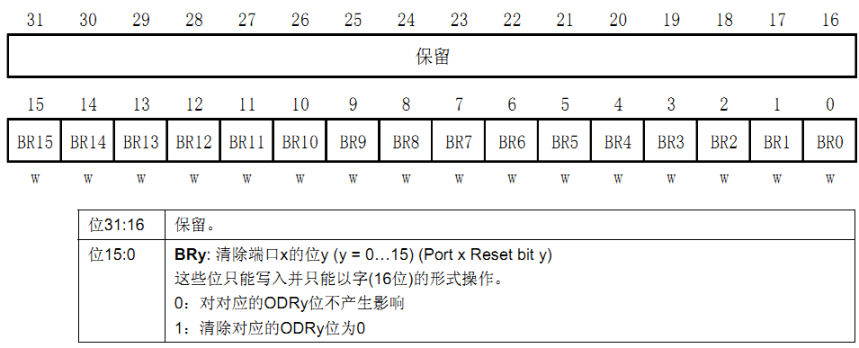
1. GPIO Function Description
-- 端口位清除寄存器(GPIOx_BRR)

Slide 22
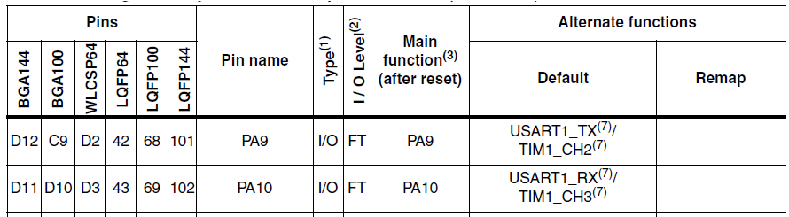
1. GPIO Function Description
-- 端口复用功能
STM32的大部分端口都具有复用功能
复用, 就是一些端口不仅仅可以做为通用IO口, 还可以复用为一些外设引脚, 比如PA9,PA10可以复用为STM32的串口1引脚
作用：最大限度的利用端口资源

Slide 23
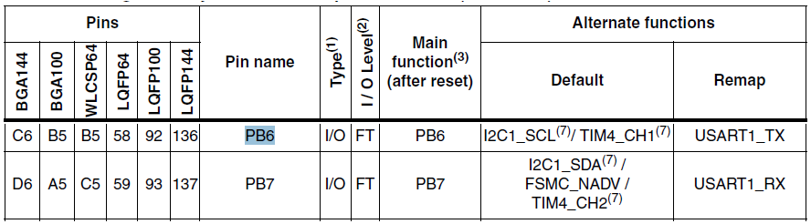
1. GPIO Function Description
-- 端口重映射功能
就是可以把某些功能引脚映射到其他引脚
比如串口1默认引脚是PA9,PA10, 可以通过配置重映射映射到PB6,PB7
作用：方便布线
所有IO口都可以作为中断输入

Slide 24
02
How to create a new project

Slide 25
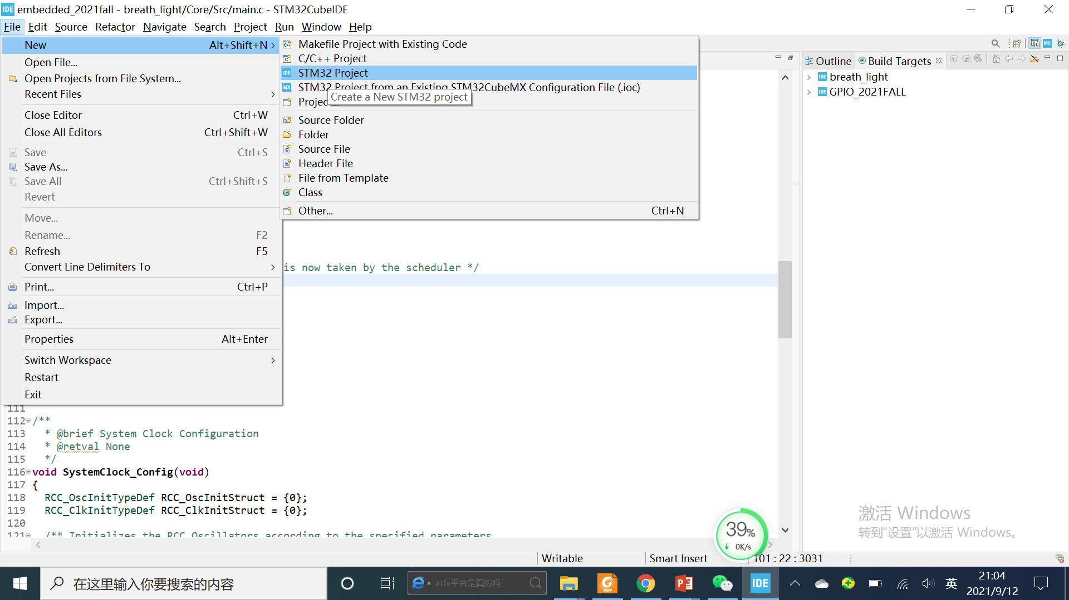
2. How to create a new project
Create a new STM32 project

Slide 26
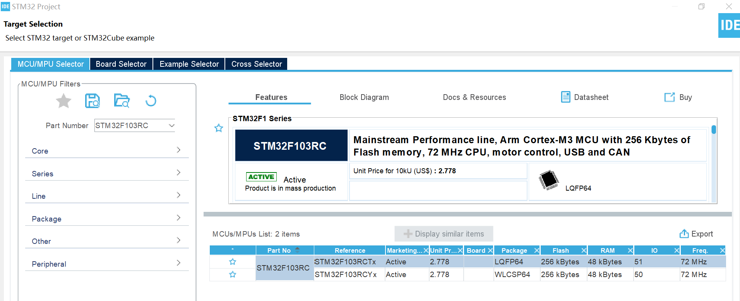
2. How to create a new project
Target selection -- STM32F103RCTx
STM32F103RCTx

Slide 27
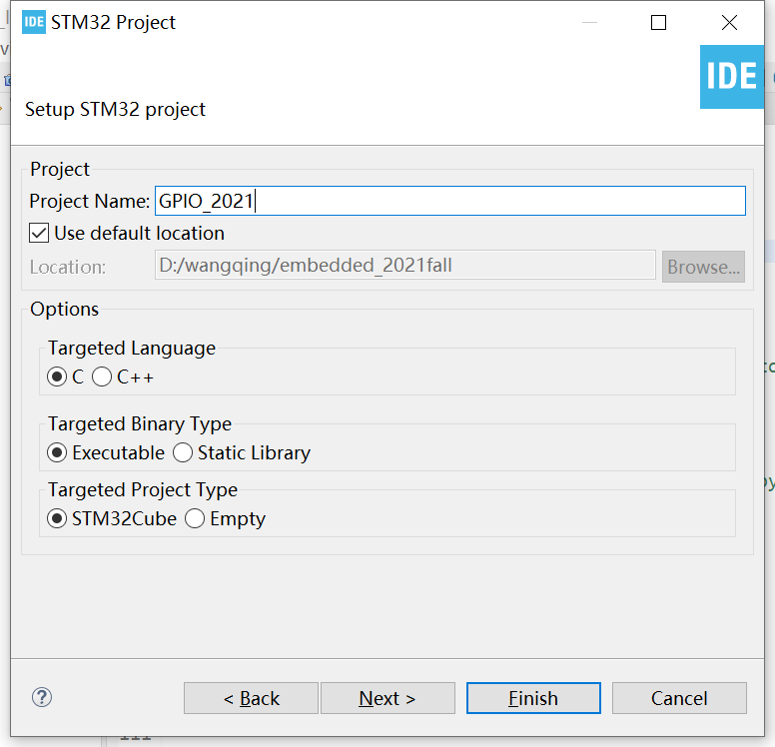
2. How to create a new project
Enter the project name – only ASCII characters
Keep other options as default

Slide 28
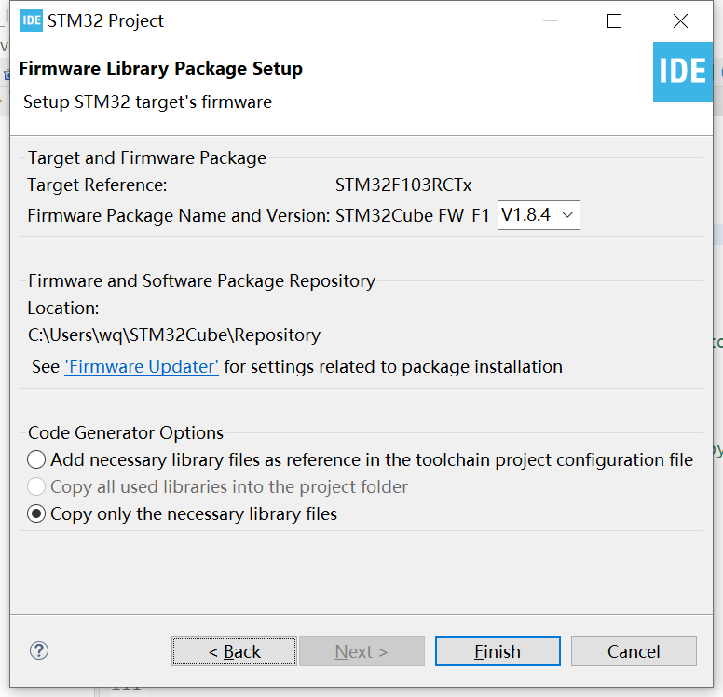
2. How to create a new project
Check the project information
Click Finish

Slide 29
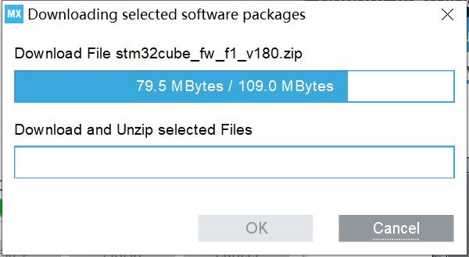
2. How to create a new project
Download software packages

Slide 30
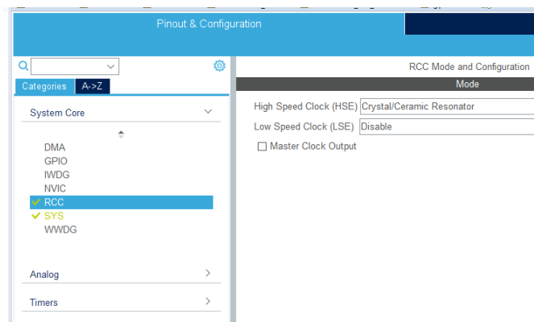
2. How to create a new project
RCC and Clock Configuration
There are four kinds of clock sources in STM32: HSE clock, HSI clock, LSE clock and LSI clock (HS for high speed, LS for low speed, E for external and I for internal)
Only HSE and HIS clock can used to driven the SYSCLK
Most of the case we use an external crystal oscillator or ceramic resonator (HSE) to drive the SYSCLK because it is more accurate

Slide 31
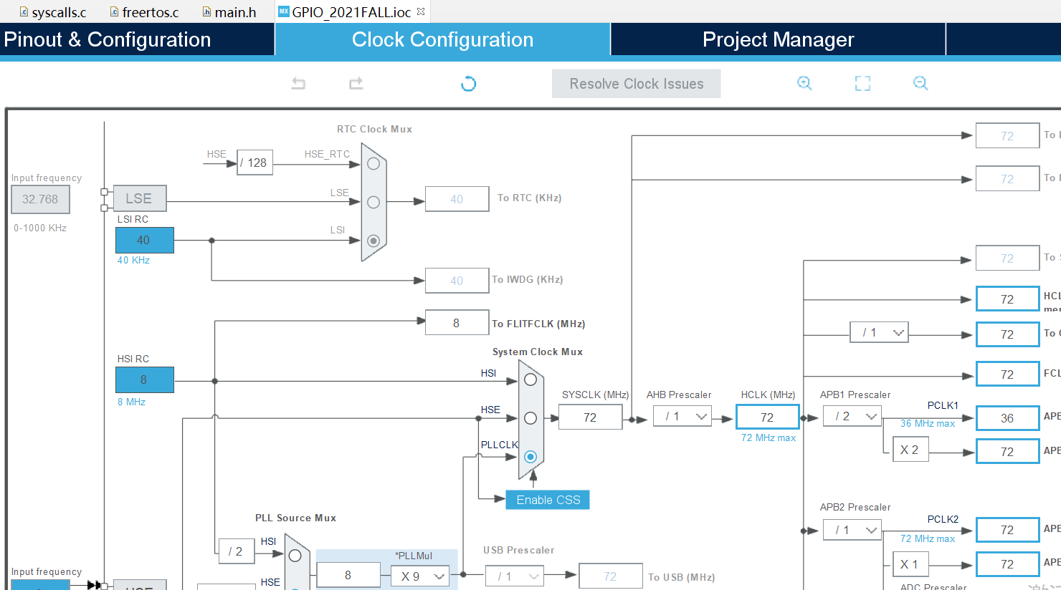
2. How to create a new project
Clock Configuration
Change to clock configuration
Set SYSCLK as 72M (maximum)

Slide 32
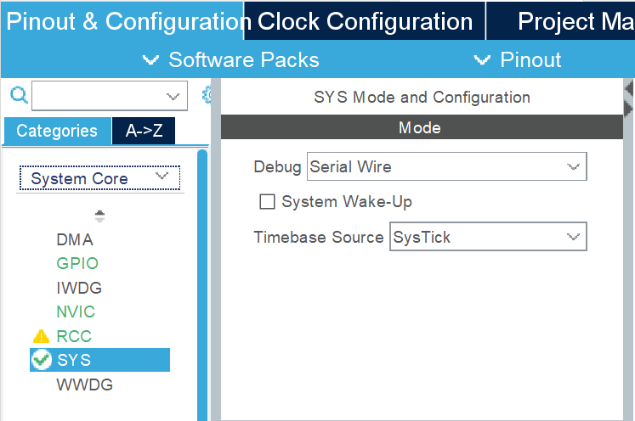
2. How to create a new project
SYS Mode and Configuration
Back to Pinout & Configuration -> Categories -> System Core -> SYS
Use Serial Wire(SW) as debug wire

Slide 33
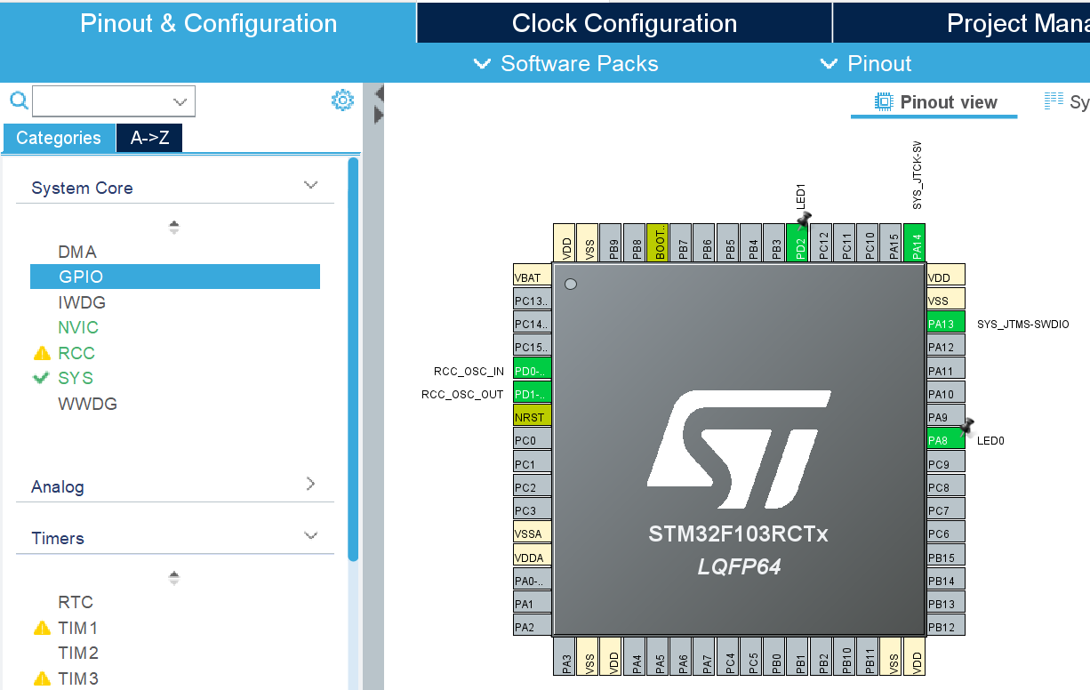
2. How to create a new project
GPIO Configuration
Still in Pinout & Configuration -> Categories -> System Core -> GPIO
Set PA8 as GPIO_Output, and rename as LED0
Set PD2 as GPIO_Output, and rename as LED1

Slide 34
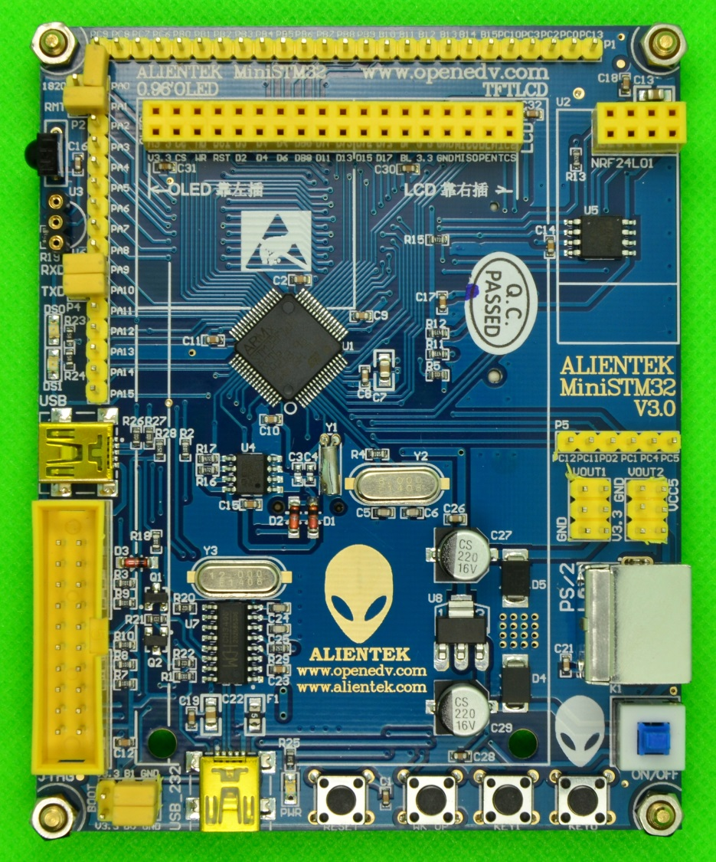
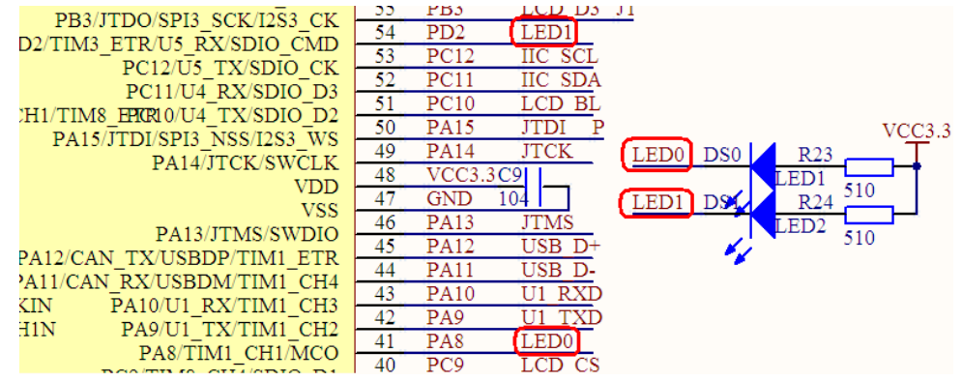
2. How to create a new project
GPIO Configuration

Slide 35
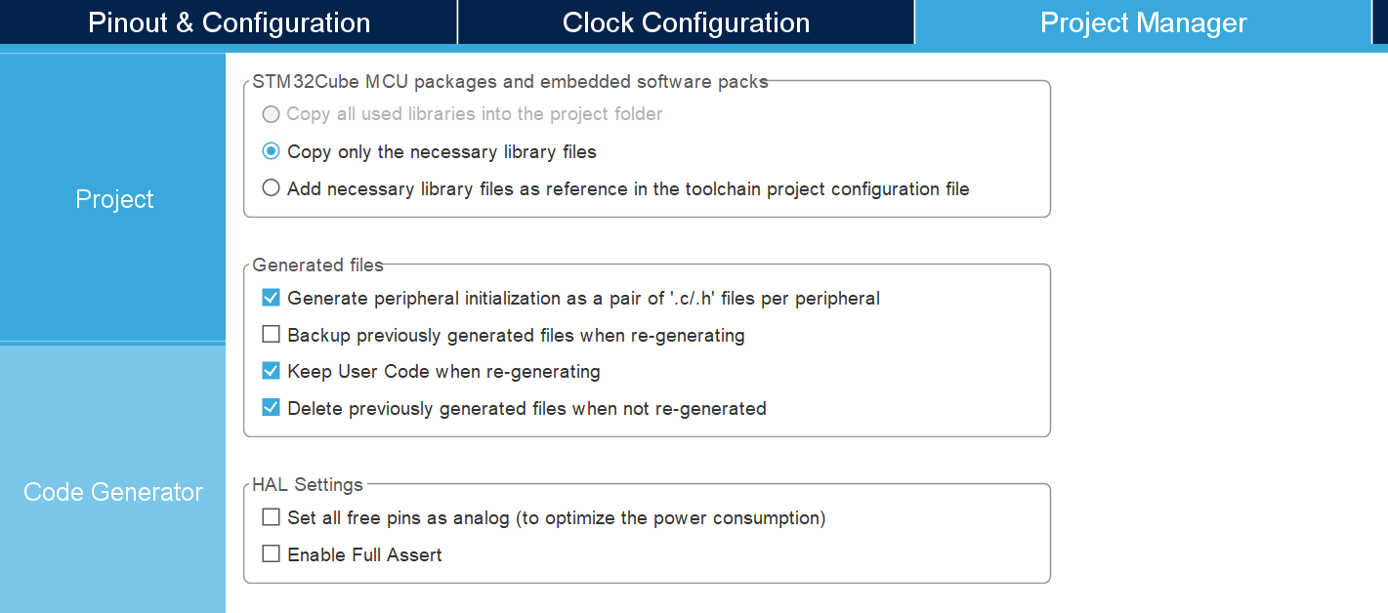
2. How to create a new project
Project Management
Change to Project Manager -> Code Generator
Check up Generate peripheral initialization as a pair of ‘.c/.h’ files per peripheral, which will make the codes more modular

Slide 36
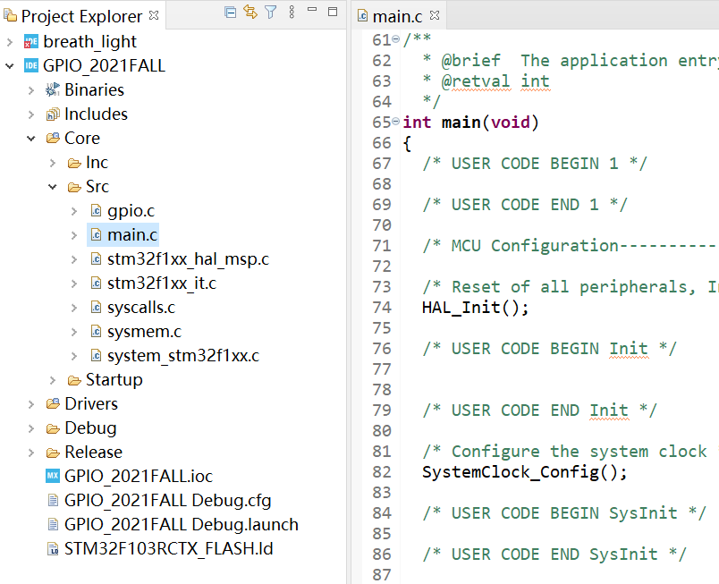
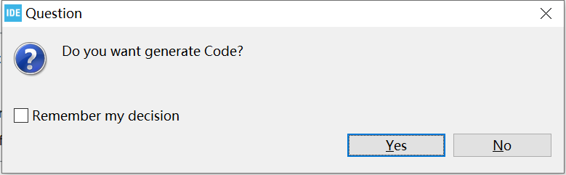
2. How to create a new project
Project Management
Save the configuration information and start a new project

Slide 37
03
How to programming

Slide 38
3. How to programming
HAL(Hardware Abstract Layer) library
Keep updating, bugs will be changed at the next version
Rapid development, work with cube tool and generate code with one click
It's convenient to replace the chip and transplant it. You don't have to think about what special registers this chip has. The manufacturer has made it for you
Learn more about HAL
https://bbs.21ic.com/icview-2512392-1-1.html?_dsign=133c8287
https://www.jianshu.com/p/c6809c2bcb4f?from=timeline

Slide 39
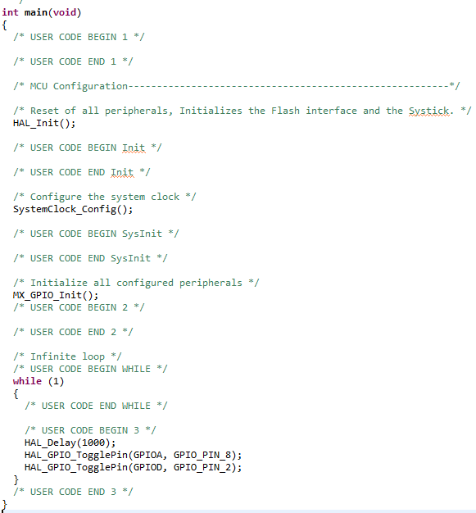
3. How to programming
STM32CubeIDE has generated codes for us according our configuration. The last thing we need to do is flash the LED
Remember to put our own codes into the USER CODE comment block, otherwise, STM32CubeIDE will overwrite them.

Slide 40
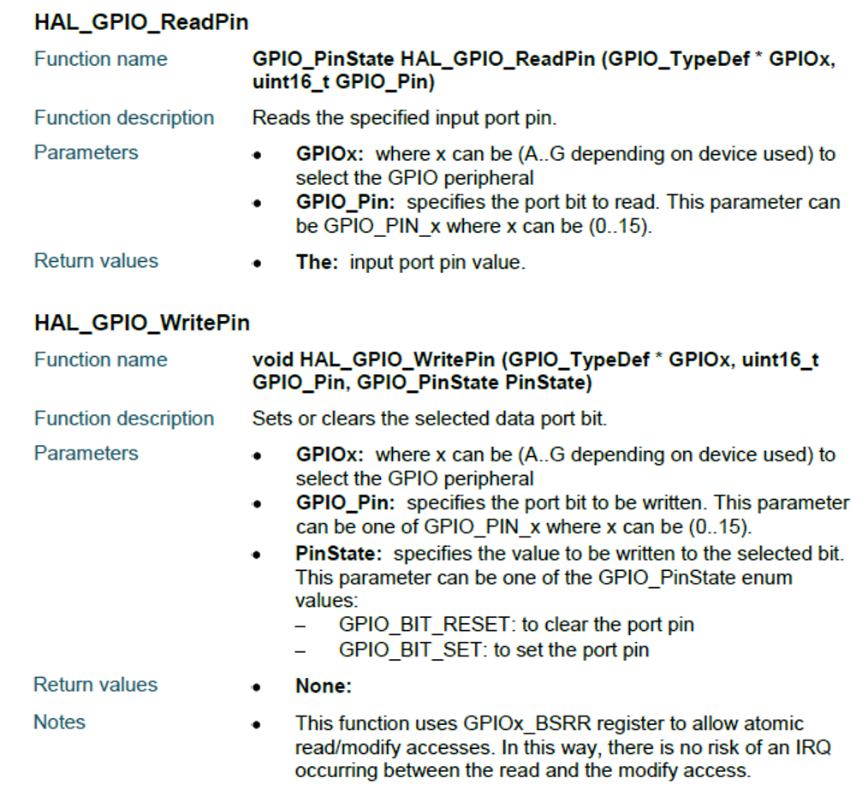
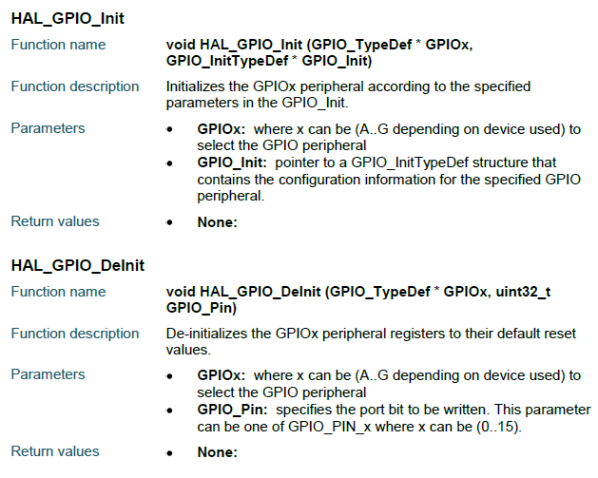
3. How to programming
Functions used frequently

Slide 41
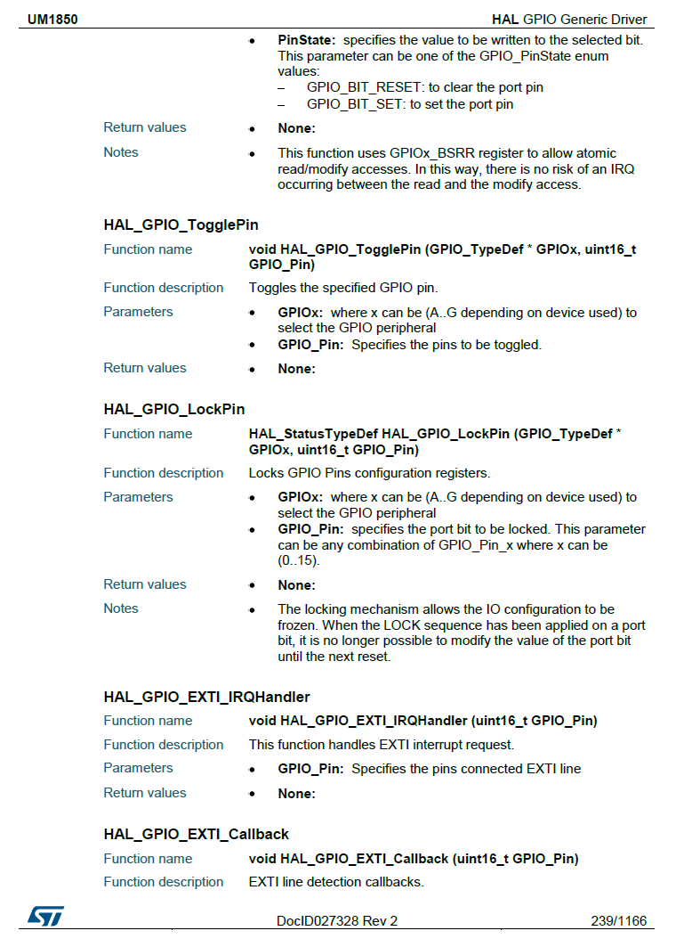
3. How to programming
Functions used frequently

Slide 42
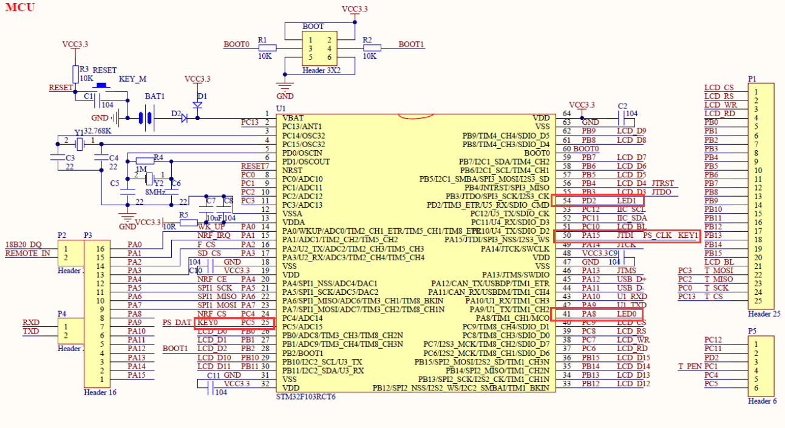
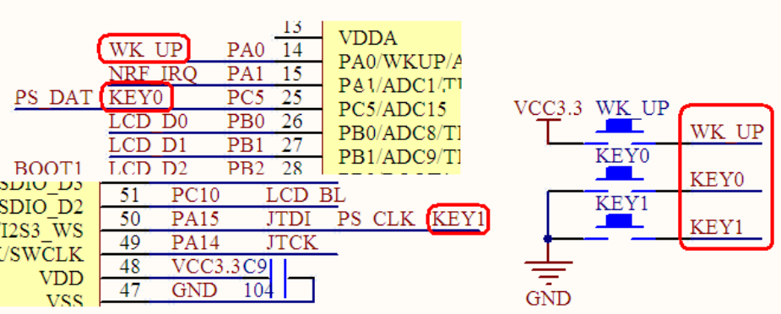
3. How to programming
Our goal this lab
On the ALIENTEK MiniSTM32 board, use KEY0 and KEY1 to control two LED DS0 and DS1 individually

Slide 43
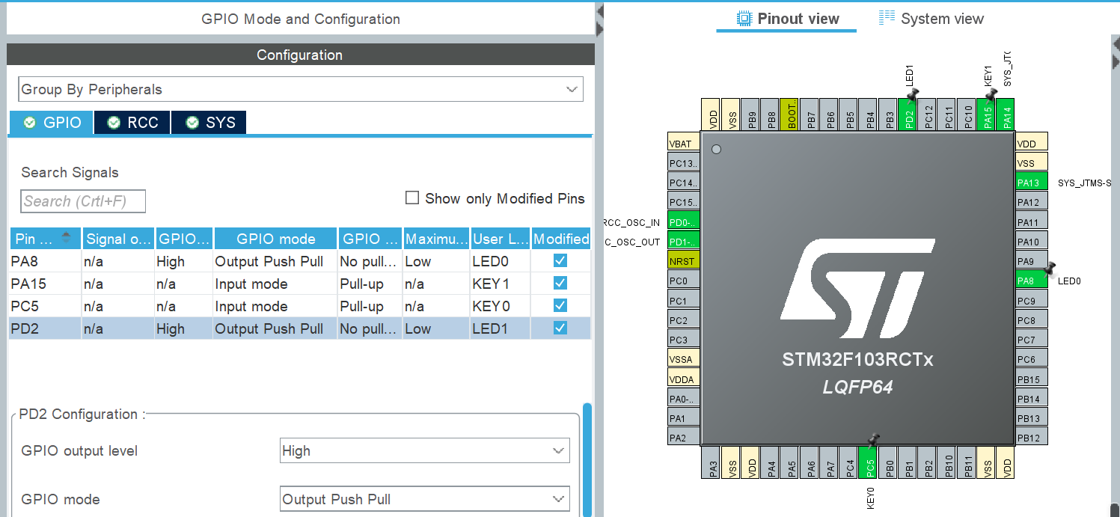
3. How to programming
GPIO Configuration
Find the pins connected to KEY0, KEY1, DS0 and DS1, which are PC5, PA15, PA8 and PD2

Slide 44
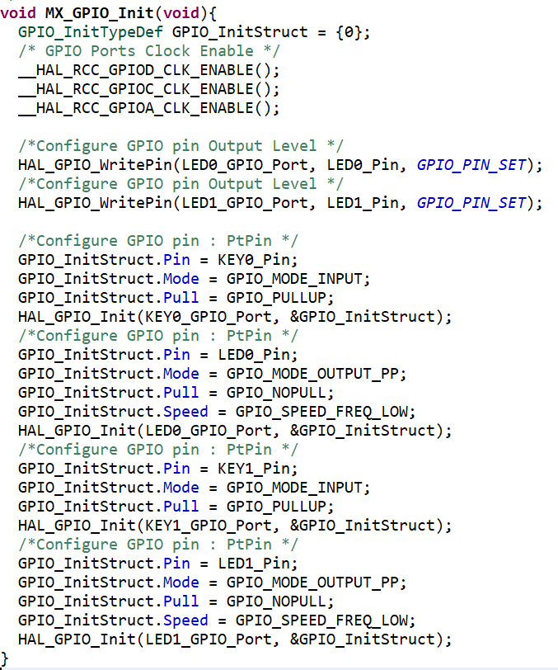
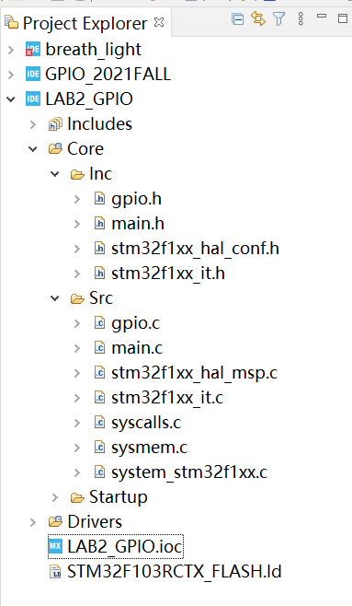
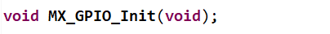
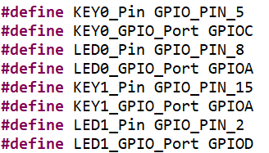
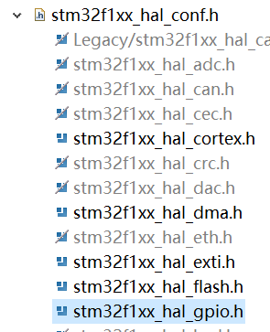
3. How to programming
The generated files and codes

Slide 45
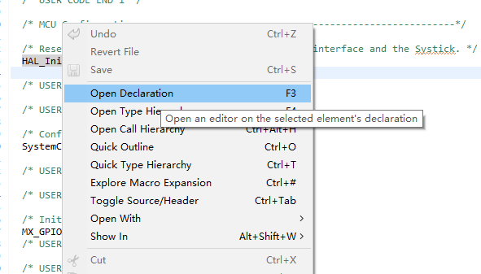
3. How to programming
Use right click menu “Open Declaration” to check the definition of functions or structures

Slide 46
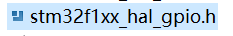
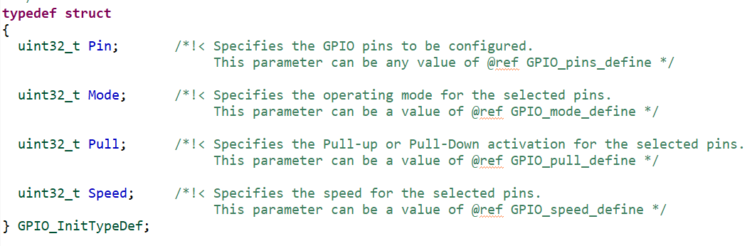
3. How to programming
The structure used frequently

Slide 47
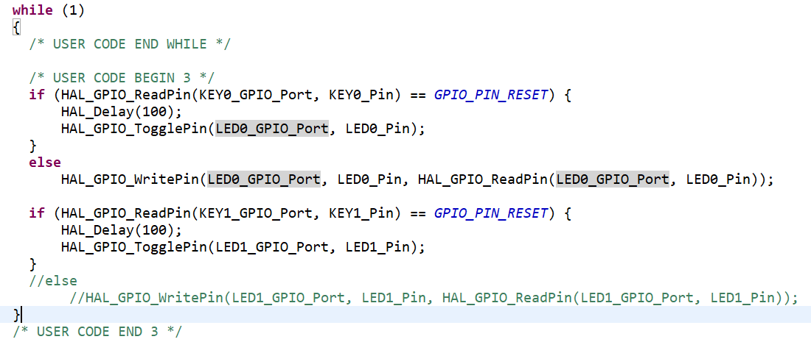
3. How to programming
Add our codes in main.c

Slide 48
04
Practice

Slide 49
4. Practice
Run the demo on MiniSTM32 board
Complete the quiz on Sakai site(it will start on Saturday and end on Monday next week)

